Slide 1
Multimedia System and Virtual Environment
CSE – 310
Lecture 9
Compression
Dept. of Computer Science and Engineering, University of Rajshahi

Slide 2
Outline
Image Compression
Data vs Information
Data Redundancy
Coding
Interpixel
Psychovisual
Dept. of Computer Science and Engineering, University of Rajshahi

Slide 3
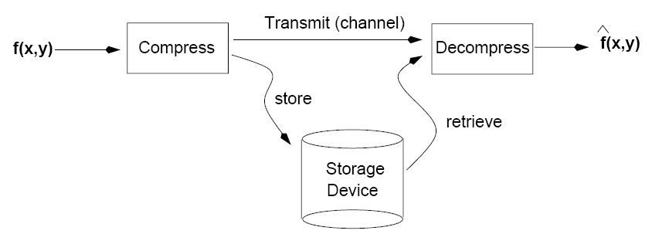
Introduction
The goal of image compression is to reduce the amount of data required to represent a digital image.
Important for reducing storage requirements and improving transmission rates.
Dept. of Computer Science and Engineering, University of Rajshahi

Slide 4
Approaches
Lossless
Information preserving
Low compression ratios
e.g., Huffman
Lossy
Does not preserve information
High compression ratios
e.g., JPEG
Tradeoff: image quality vs compression ratio
Dept. of Computer Science and Engineering, University of Rajshahi

Slide 5
Data vs Information
Data and information are not synonymous terms!
Data is the means by which information is conveyed.
Data compression aims to reduce the amount of data required to represent a given quantity of information while preserving as much information as possible.
Dept. of Computer Science and Engineering, University of Rajshahi

Slide 6
Data vs Information (cont’d)
The same amount of information can be represented by various amount of data, e.g.:
Ex1:
Your wife, Helen, will meet you at Logan Airport in Boston at 5 minutes past 6:00 pm tomorrow night
Your wife will meet you at Logan Airport at 5 minutes past 6:00 pm tomorrow night
Helen will meet you at Logan at 6:00 pm tomorrow night
Ex2:
Ex3:
Dept. of Computer Science and Engineering, University of Rajshahi

Slide 7
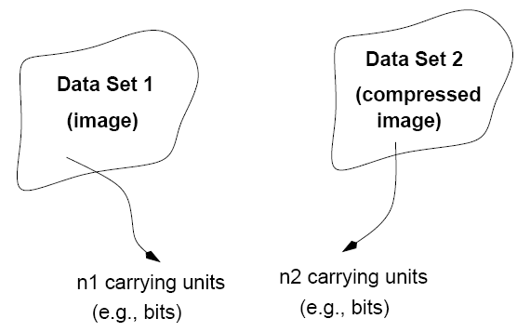
Data Redundancy
Data redundancy is a mathematically quantifiable entity!
n₁, n₂ = # information carrying units in two datasets.
compression
Dept. of Computer Science and Engineering, University of Rajshahi

Slide 8
Data Redundancy (cont’d)
Compression ratio:
Relative data redundancy:
Example:
Dept. of Computer Science and Engineering, University of Rajshahi

Slide 9
Types of Data Redundancy
(1) Coding
(2) Interpixel
(3) Psychovisual
The role of compression is to reduce one or more of these redundancy types.
Dept. of Computer Science and Engineering, University of Rajshahi

Slide 10
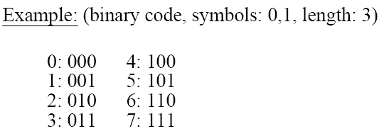
Coding Redundancy
Data compression can be achieved using an appropriate encoding scheme.
Example: binary encoding
Dept. of Computer Science and Engineering, University of Rajshahi
Notes:
10

Slide 11
Encoding Schemes
Elements of an encoding scheme:
Code: a list of symbols (letters, numbers, bits etc.)
Code word: a sequence of symbols used to represent a piece of information or an event (e.g., gray levels)
Code word length: number of symbols in each code word
Dept. of Computer Science and Engineering, University of Rajshahi

Slide 12
Definitions
N x M image
r_{k}: k-th gray level
P(r_{k}): probability of r_{k}
L : # of gray levels
Dept. of Computer Science and Engineering, University of Rajshahi

Slide 13
Avoiding Coding Redundancy
To avoid coding redundancy, codes should be selected according to the probabilities of the events.
Variable Length Coding
Assign fewer symbols (bits) to the more probable events (e.g., gray levels for images)
Dept. of Computer Science and Engineering, University of Rajshahi

Slide 14
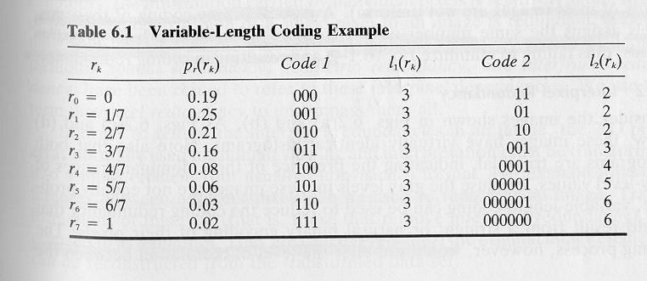

Constant Length Coding
l(r_{k}) = c which implies that L_{avg}= c
Example:
Dept. of Computer Science and Engineering, University of Rajshahi

Slide 15
Variable Length Coding
Consider the probability of the gray levels:
variable length
2*.19 + 2*.25 + 2*.21 + 3*.16 + 4*.08 + 5*.06 + 6*.03 + 6*.02 = 2.7
Dept. of Computer Science and Engineering, University of Rajshahi

Slide 16
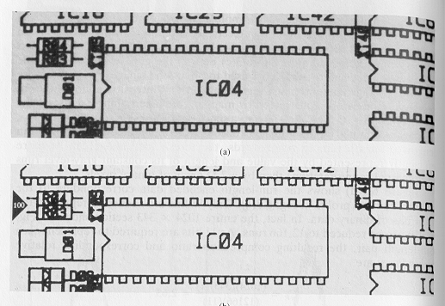
Interpixel redundancy (cont’d)
To reduce interpixel redundnacy, the data must be transformed in another format (i.e., through a transformation)
e.g., thresholding, or differences between adjacent pixels, or DFT
Example:
Original
Thresholded
Dept. of Computer Science and Engineering, University of Rajshahi

Slide 17
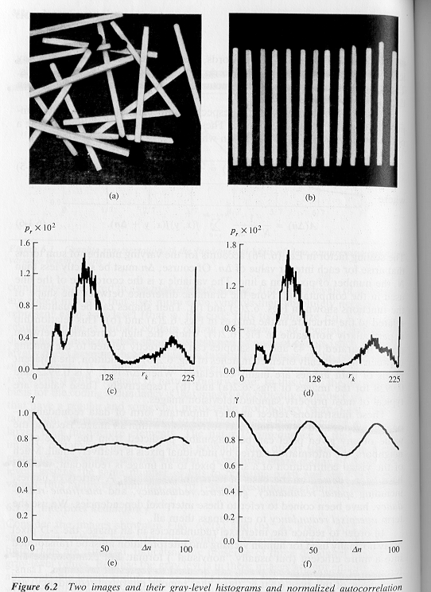
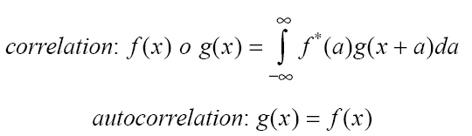
Interpixel redundancy
Interpixel redundancy implies that any pixel value can be reasonably predicted by its neighbors (i.e., correlated).
Dept. of Computer Science and Engineering, University of Rajshahi

Slide 18
Psychovisual redundancy
Takes into advantage the peculiarities of the human visual system.
The eye does not respond with equal sensitivity to all visual information.
Humans search for important features (e.g., edges, texture, etc.) and do not perform quantitative analysis of every pixel in the image.
Dept. of Computer Science and Engineering, University of Rajshahi

Slide 19
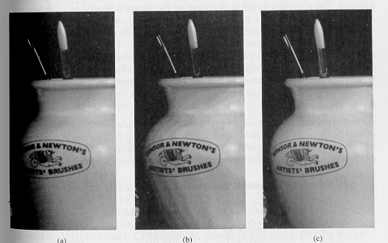
Psychovisual redundancy (cont’d) Example: Quantization
16 gray levels
improved gray-scale quantization
256 gray levels
16 gray levels
8/4
=
2:1
i.e., add to each pixel a
pseudo-random number
prior to quantization
Dept. of Computer Science and Engineering, University of Rajshahi

